Slide 1
CS 383 - Module 2: Enterprise web application Architecture
Classical, Ajax, SPA

Slide 2
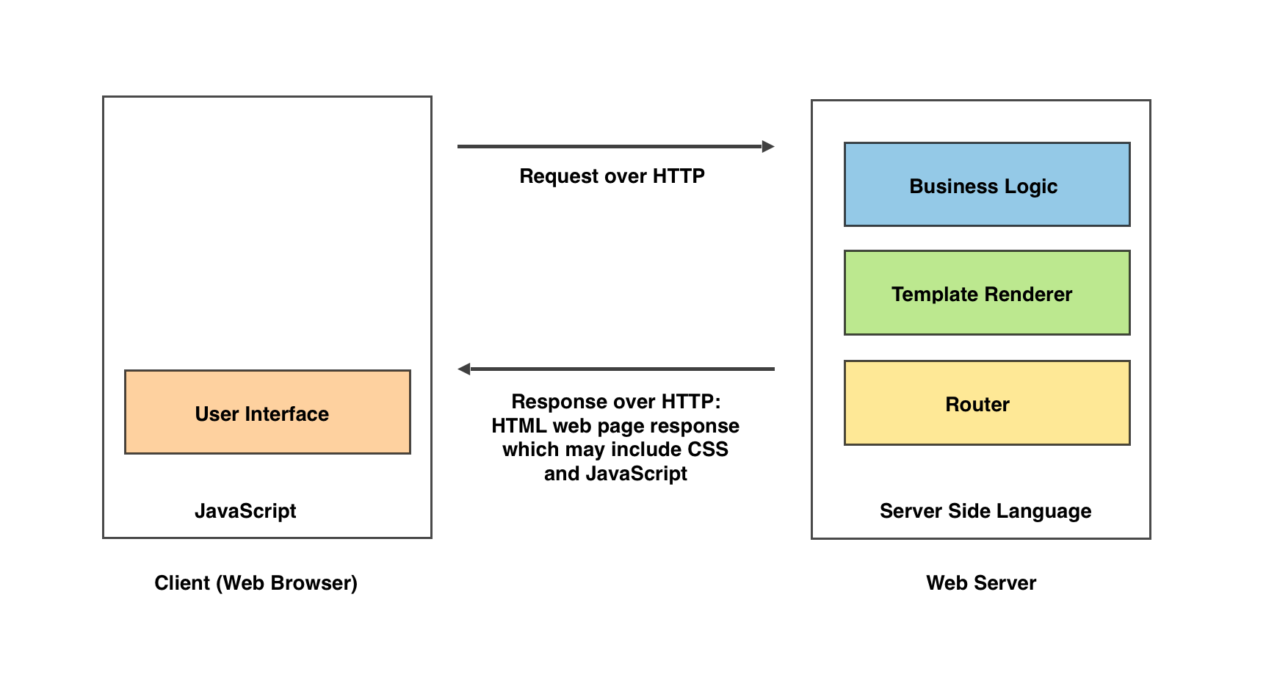
Classic web application architecture
The classic web application architecture dates back to the early 1990s, when graphical web browsers started to gain traction. When the user interacts with a web server using a web browser, each user interaction, makes a request to a web server using HTTP

Slide 3
Classic web application architecture
There are two types of resources that the web server can return in the form of a response: a static resource and a dynamic resource.
A static resource is a file. For example, it could be an HTML, JPEG, PDF, or MP4 file that lives on the web server. The server will return the document specified by the request in its response body.
A dynamic resource is a resource that gets built by the server on the fly. An example of a dynamic resource is a search engine's search results page. Usually, the response body of a dynamic request will be formatted in HTML.
A server-side programming language (such as Go, Perl, PHP, Python, Ruby, and Java) is used to process the requests sent from the web browser

Slide 4
Classic web application architecture
Advantages:
Faster initial page loads
Greater search engine discoverability
Disadvantages:
all user interactions require a full page reload.

Slide 5
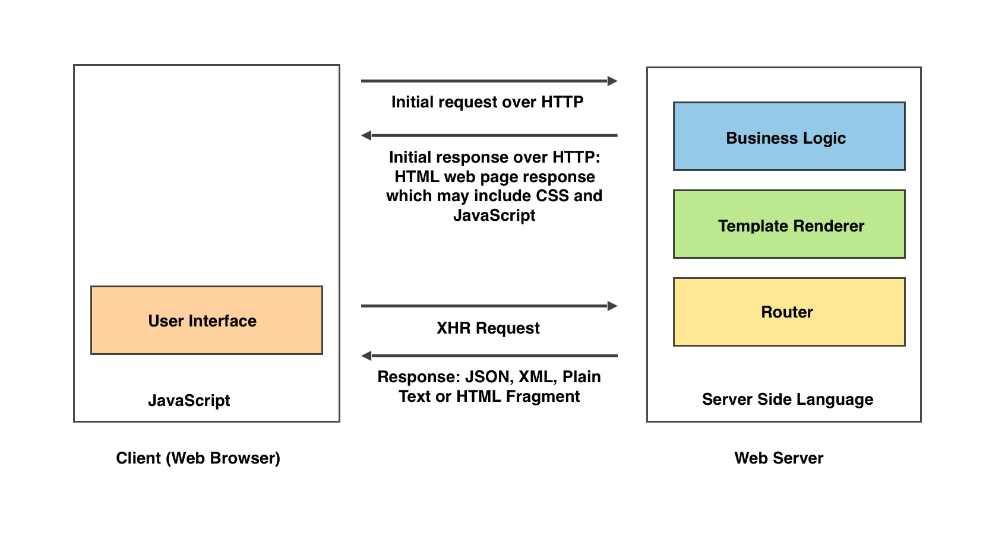
The AJAX web application architecture
With the advent of the XMLHttpRequest (XHR) object, the Asynchronous JavaScript And XML (AJAX) era began

Slide 6
The AJAX web application architecture
After the client's initial request, the server sends back a web page response containing HTML, CSS, and JavaScript. Once the web page has finished loading, the JavaScript application on the client side may initiate asynchronous requests back to the web server over HTTP, using the XHR object.
Some observers have characterized the advent of AJAX as the Web 2.0 era
Because the XHR calls are asynchronous in nature, they don't block the single threaded JavaScript application running in the web browser. Once a response is received from the server for a given XHR request, an action can be taken with the data that was returned from the server.

Slide 7
The AJAX web application architecture
Advantages:
Removes the need to perform a full page reload
Disadvantages:
Handling the mental context switch between two programming languages
The complexity introduced by performing piecemeal client-side rendering
The duplication of efforts

Slide 8
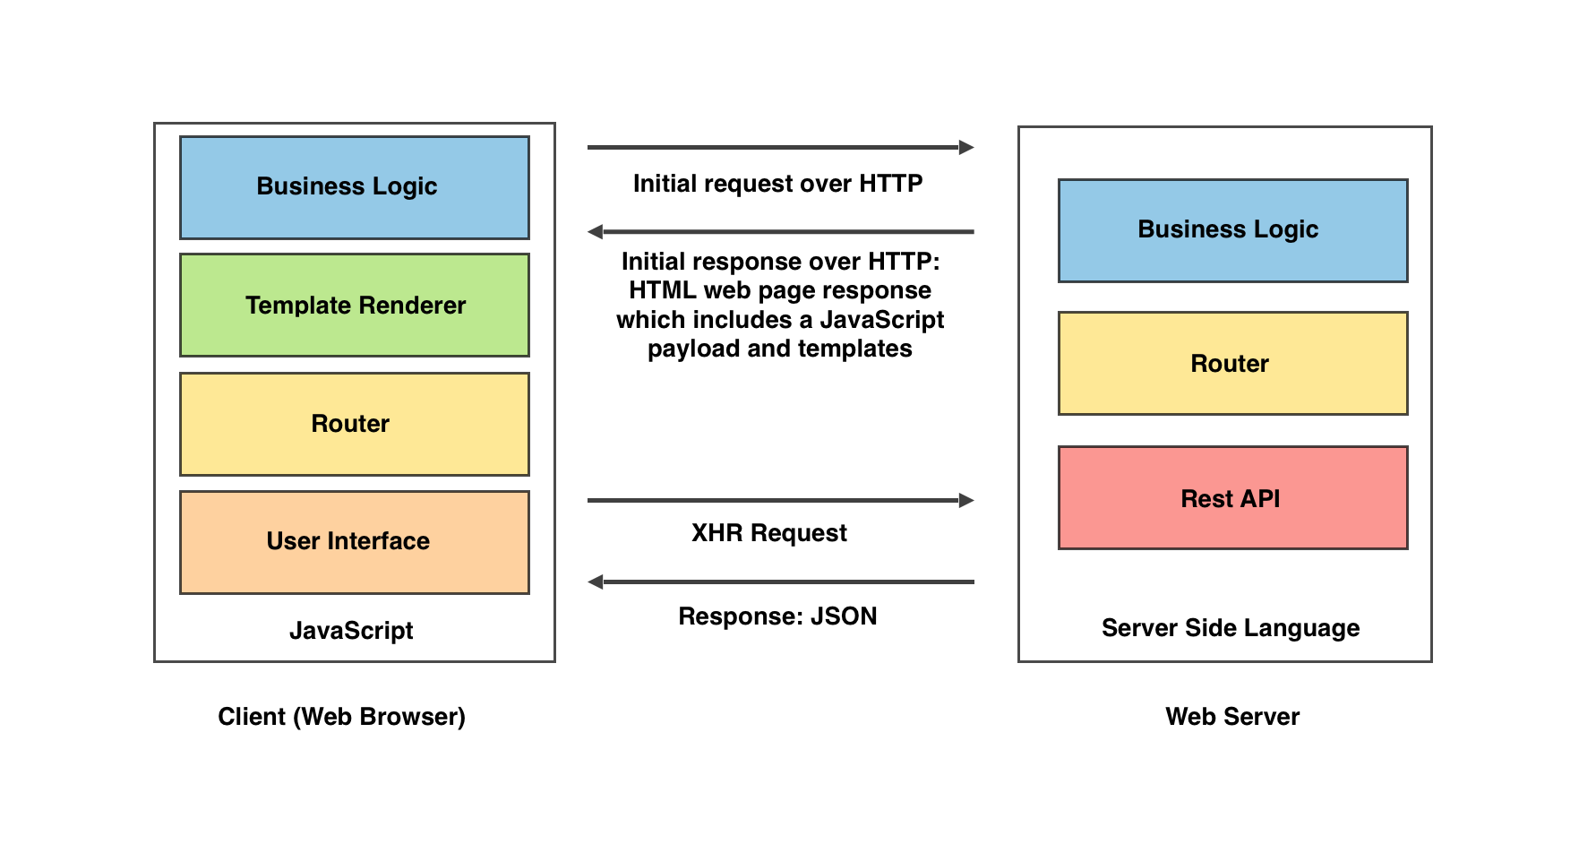
The single page application (SPA) architecture
In 2004, the World Wide Web Consortium (W3C) started working on the new HTML standard, which was to be the precursor to HTML5. In 2010, HTML5 started to pick up speed, and features from the specification started to make their way into the major web browsers and the HTML5 functionality became very popular

Slide 9
The single page application (SPA) architecture
HTML5 introduces capabilities that would allow web applications to behave more like native applications. A new set of APIs that were accessible through JavaScript were introduced. These APIs included the functionality to store data locally on the user's device, better control of the forward and back button (using the web browser's History API), a 2D canvas for rendering graphics, and the second version of the XHR object that included greater capabilities than its predecessor.
In the early 2010s, JavaScript frameworks began to emerge, which facilitated in the development of a new type of architecture, the SPA architecture
The SPA architecture removes the duplication of efforts for user interface responsibilities. It does so by consolidating all UI code to the client. Doing so eliminates the duplication of efforts on the server side in terms of the user interface.

Slide 10
The single page application (SPA) architecture
Advantages:
Provides client-side routing, preventing full page reloads
Disadvantages:
The initial page loads are perceived to be slower
Reduced search engine discoverability

